Slide 1

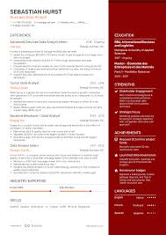
Resume classification and search
Automated Resume Parsing, Skill Extraction, and Classification Using Machine Learning
Mentors:
Snehal Shinde
B Harish
From Group : 2

Slide 2
From : Group 2
Name:
1: Muskawad Raman Sopan
2: Waghmare Priti Siddhart
3: Jahanvi Tammu
4: Mr.Bhanu Prasad
5: Kalpesh Patil
6: Chintha Likhita

Slide 3
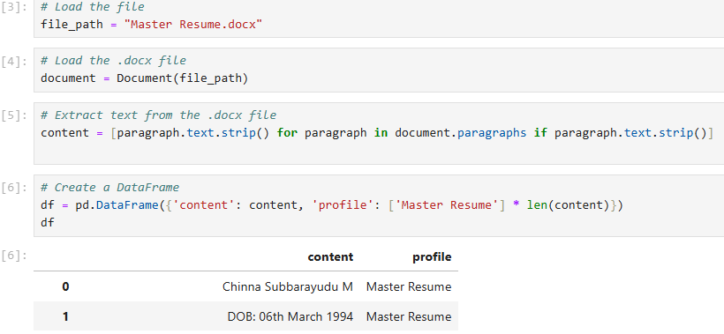
Introduction :
Purpose:
Simplify resume screening with automated tools.
Features:
Extract text from resumes (.docx, .pdf).
Identify technical skills and experience.
Classify resumes using machine learning.
Search and rank resumes based on criteria.

Slide 4
Key Components & Technical Stack :
Technical Stack:
Python libraries: Streamlit, scikit-learn, TfidfVectorizer, PyPDF2.
Predefined technical skills for matching.
Machine Learning:
Gradient Boosting Classifier for classification.
Data Processing:
TfidfVectorizer for text similarity.
Regex for experience extraction.

Slide 5
Features and Functionality :
Key Functionalities:
Resume Extraction: Supports .docx and .pdf formats.
Text Processing: Extracts skills and experience.
Search and Filter: Allows criteria-based filtering.
Model Training: Uses Gradient Boosting Classifier.

Slide 6
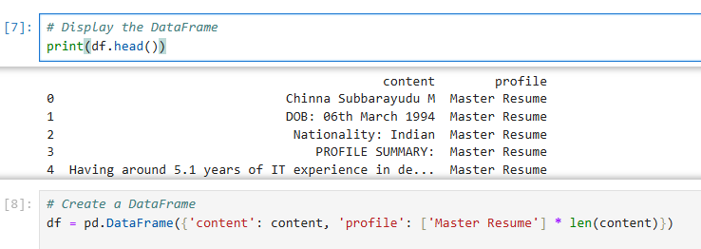
EDA and Visualizations :
Exploratory Data Analysis (EDA):
Analyzing the distribution of key features such as skills, experience years, and resume categories.
Visualizations:
Bar Charts: Display skill frequency in resumes.
Word Clouds: Highlight most common skills across resumes.
Experience Distribution: Visualize the years of experience among resumes.

Slide 7
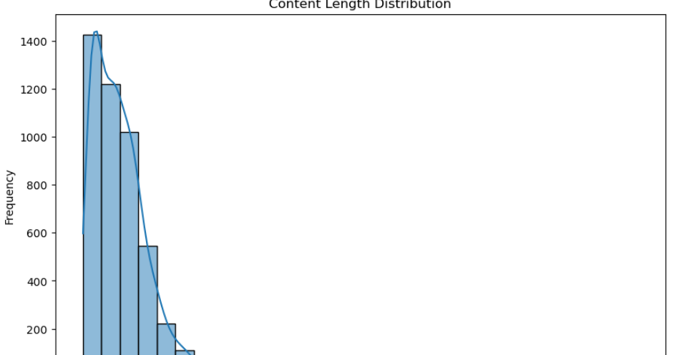
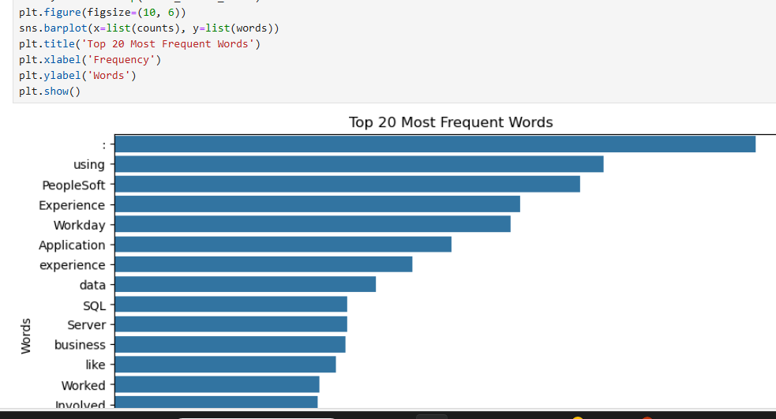
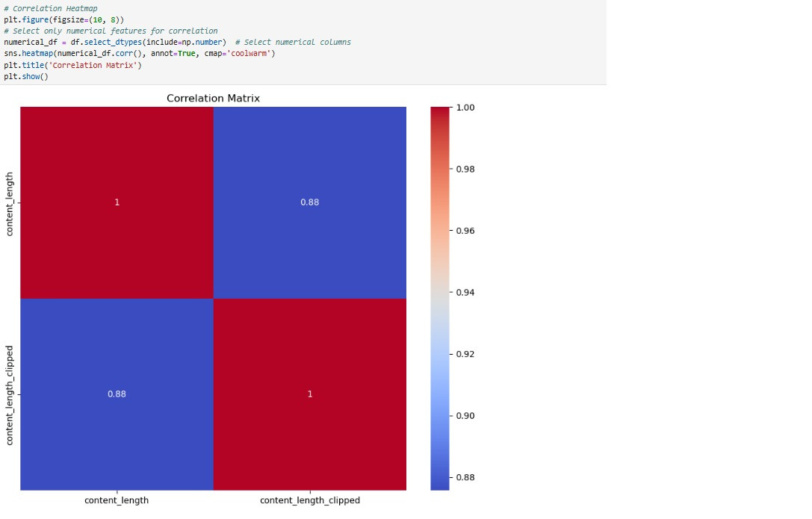
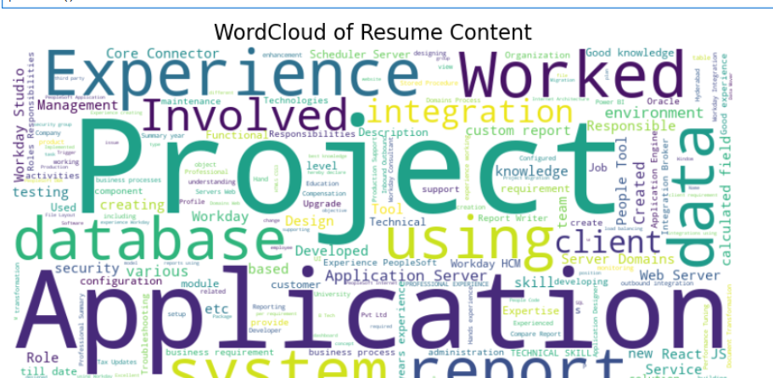
EDA & Visualizations part:
Plots:Histplot, Barplot,Heatmap,WordCloud,etc

Slide 8
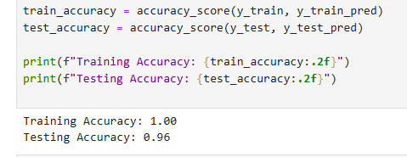
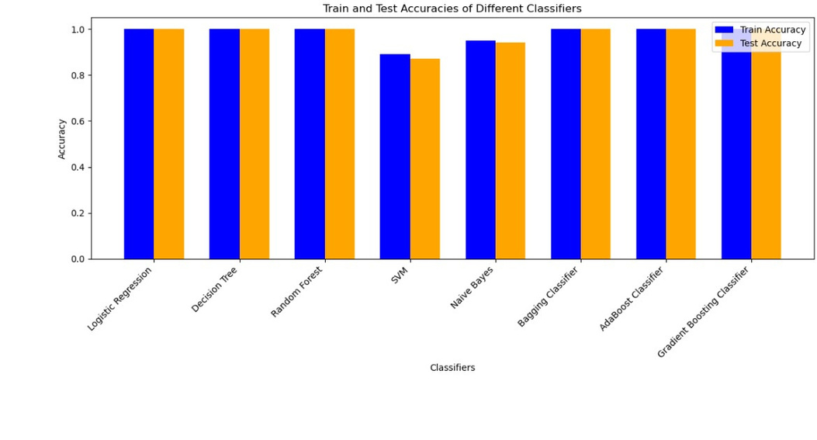
Model Evaluation & Improvements :
Model Performance:
Accuracy, Precision, Recall, and F1-score.
Improvement Techniques:
Hyperparameter Tuning.
Cross-validation to ensure model generalization.

Slide 9
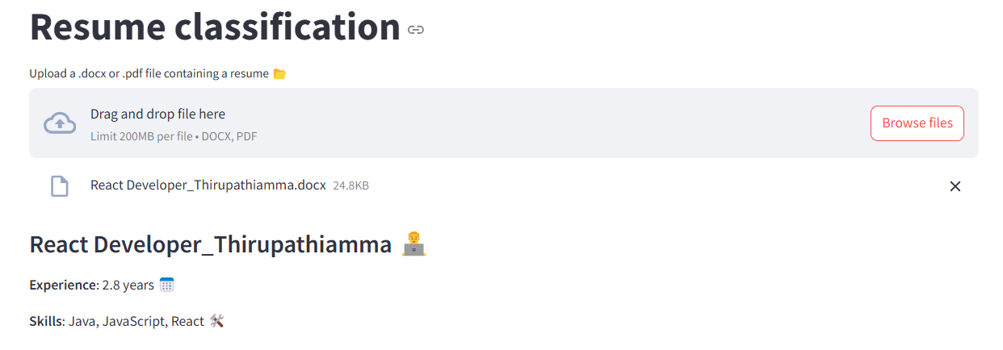
Deployment & Scalability :
Deployment Process:
Deploy the Streamlit app on cloud platforms (AWS, Heroku, Google Cloud).
Scalability:
Ensure scalability for handling large datasets of resumes.
Use parallel processing to speed up processing time.

Slide 10
Challenges and Considerations :
Key Challenges:
Handling varied resume formats.
Extracting structured data from unstructured text.
Considerations:
Balancing search specificity and broad applicability.

Slide 11
Future Enhancements and Conclusion :
Future Enhancements:
Integration with ATS systems.
Multilingual resume support.
Advanced classification techniques.
Conclusion:
Streamlines recruitment processes, saves time, and improves productivity.
Efficient solution for resume parsing and classification using advanced ML techniques.

Slide 12
Thank you

